Slide 1
THESIS PRESENTATION
Kanishk Yadav
Clean Energy Lab
University of Toronto
Supervised by Prof. Oleksandr Voznyy & Co-supervised by Prof. K Sumithra

Slide 2
AGENDA
What is Machine Learning?
What are GNNs and why do we need them in chemistry?
Problem Statement
Implementation
Analysis
Challenges
Future Work

Slide 3
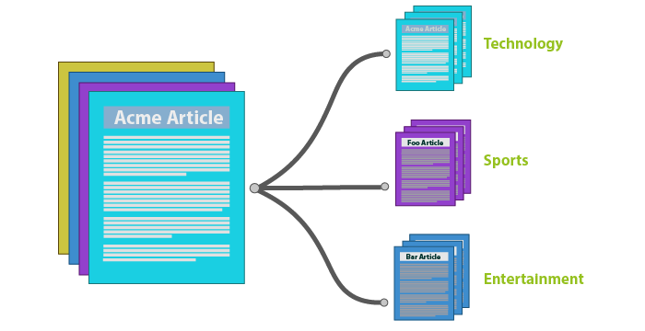
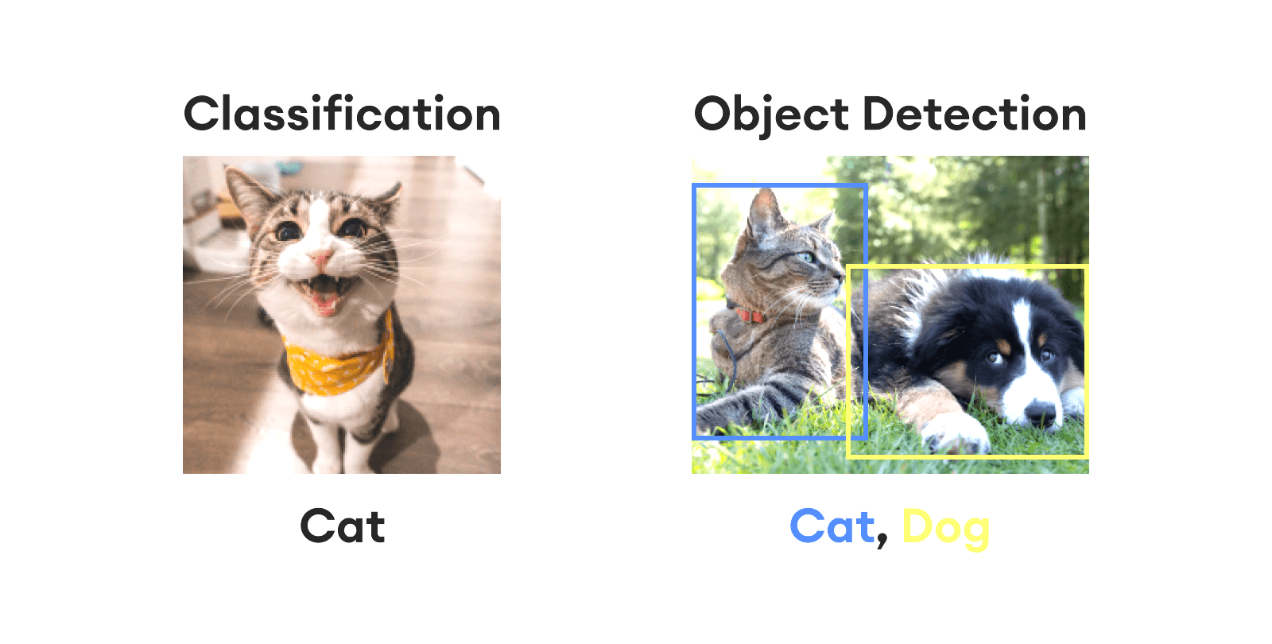
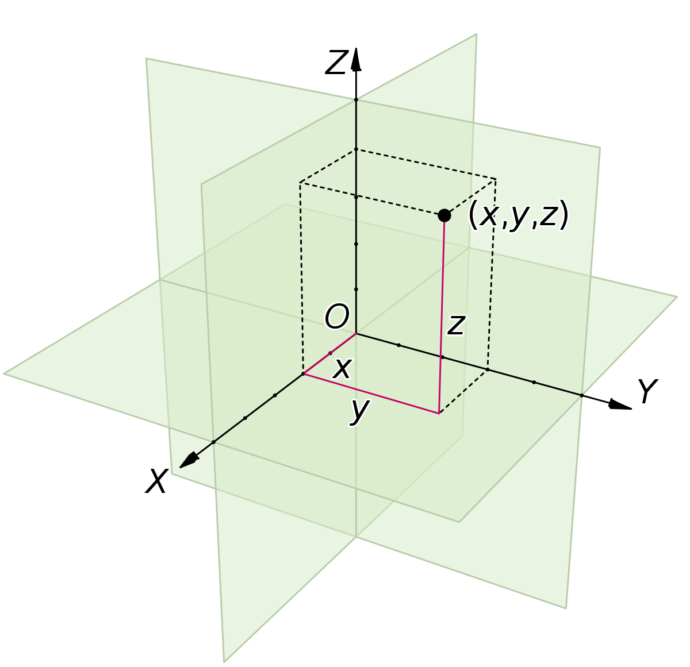
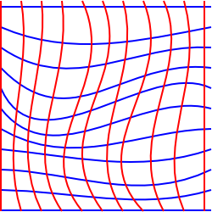
Machine learning
Subset of AI that involves training algorithms to recognize patterns and make predictions
Labeled data to train a model, which can then make predictions on new, unseen unlabeled data (supervised)
Image Classification, Speech Recognition, Video Processing
Geometric representation of data: Euclidean & Non-Euclidean
Fixed-size, non-complex sequences and grids with notion of reference point

Slide 4
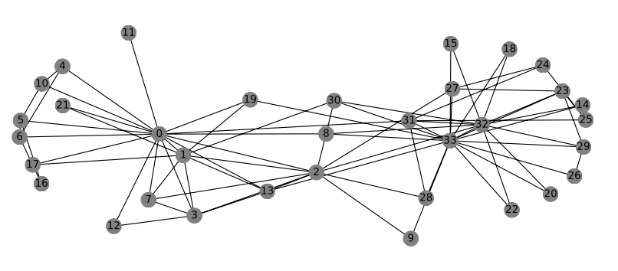
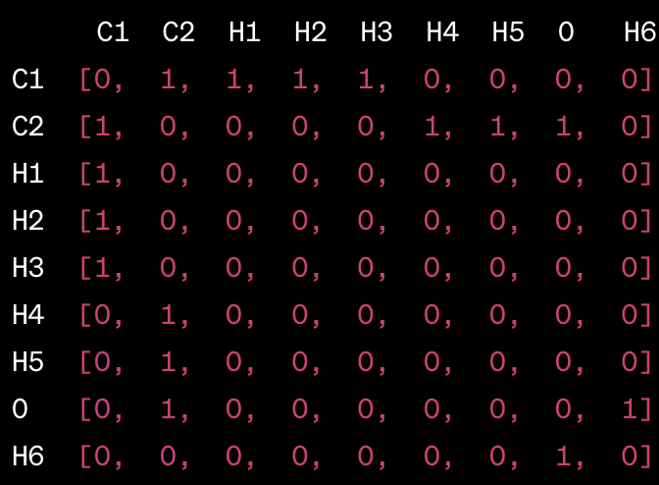
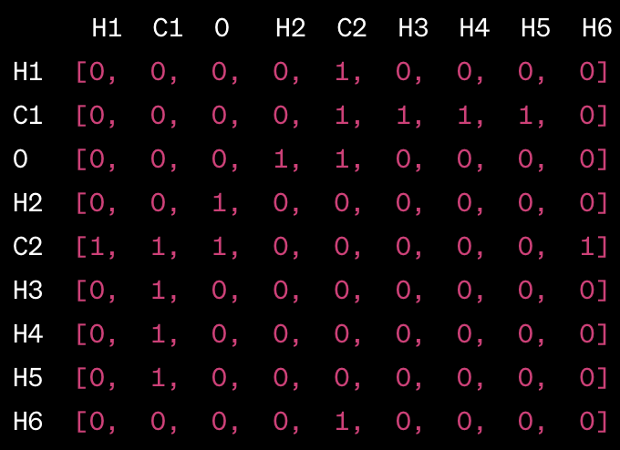
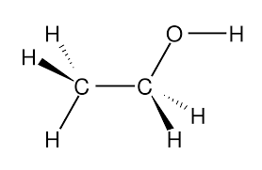
GRAPH NEURAL NETWORKS in chemistry
How do we represent molecules?
Complex, non-fixed size, no fixed node ordering, no notion of reference point
C₂H₅OH (need for non-permutation invariance)
Need for GNNs
Node order: C, C, H, H, H, H, H, O, H
Node order: H, C, O, H, C, H, H, H, H

Slide 5
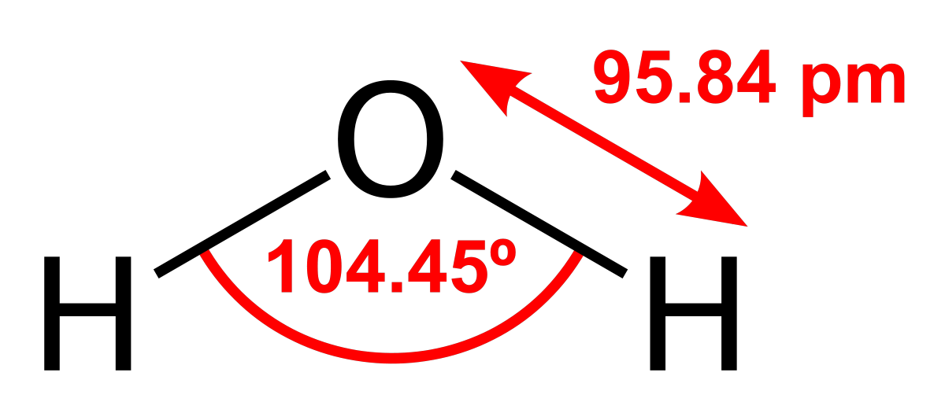
Feature representation
Distinctive attributes of data capturing relevant information
Node (atom) features: Atomic number, valency, electronegativity, atomic radius
Edge (bond) features: Bond type, bond length, bond angle
Graph-level (molecule) features: Polarity, number of rings, aromaticity
node
O: [8(atomic number), 2(valence), 3.44(electronegativity), 60(atomic number)]
H: [1(atomic number), 1(valence), 2.20(electronegativity), 31(atomic number)]
O-H: [1(single bond), 95.84(bond length), 104.5(bond angle)]
edge

Slide 6
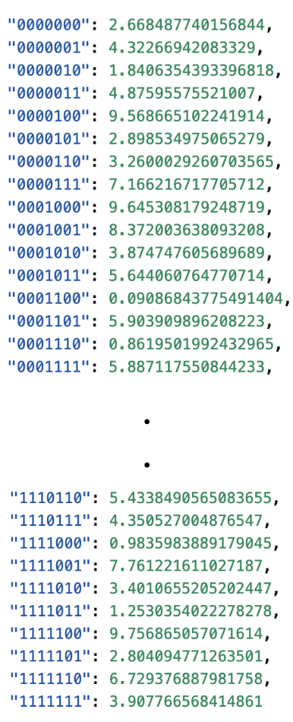
THE SUMMATION PROBLEM
Reverse-engineer the properties of atoms by studying the molecules they form
Learn about the properties of individual atoms (real number) based on the properties of the molecules (sum of individual real numbers) without directly observing the atoms
Binary representation of data (7 bits - 128 atoms)
Dataset
Goal is to learn about the atom value using only its binary representation and the sum it generates with other atoms in molecule
(0000000, 0000001, 000010) = 2.668 + 4.322 + 1.840 = 8.83
0 | 0 | 0 | 0 | 0 | 0 | 0
1 | 1 | 1 | 1 | 1 | 1 | 1
0 | 0 | 0 | 0 | 0 | 0 | 0 | 0 | 0 | 0 | 0 | 0 | 0 | 1 | 0 | 0 | 0 | 0 | 0 | 1 | 0

Slide 7
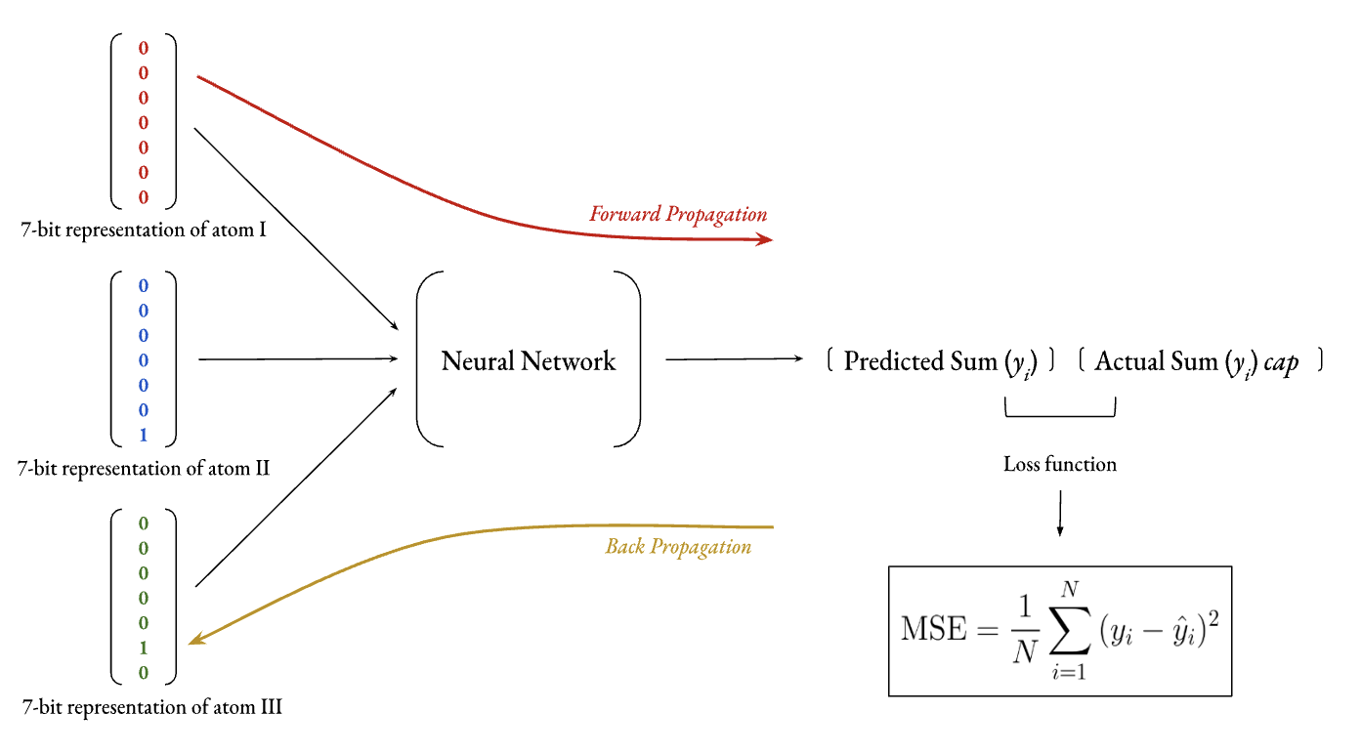
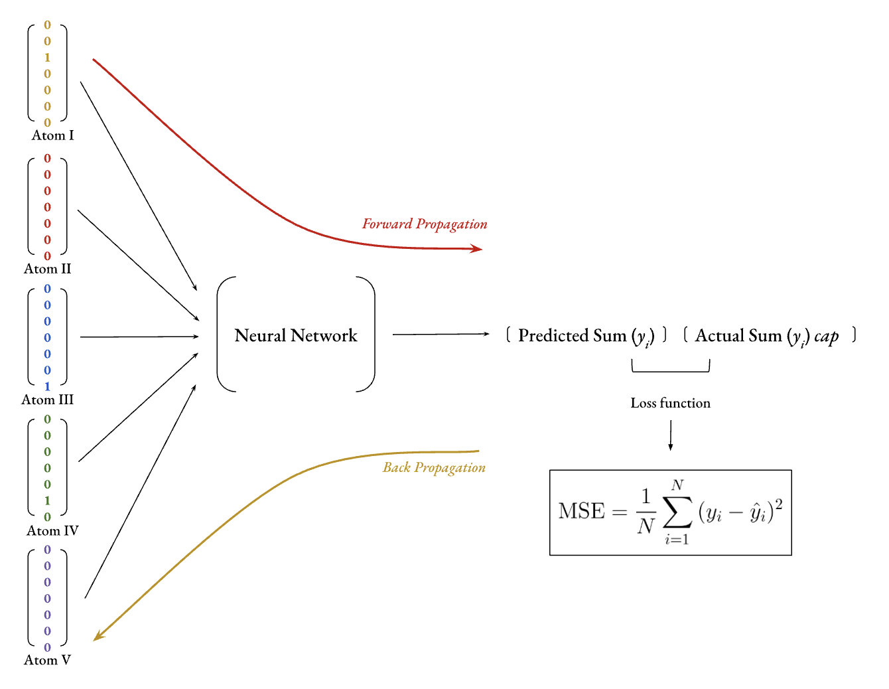
Network architecture
5 atom version (128⁵)
3 atom version (128³)
n atom version (128^{n} combinations)

Slide 8
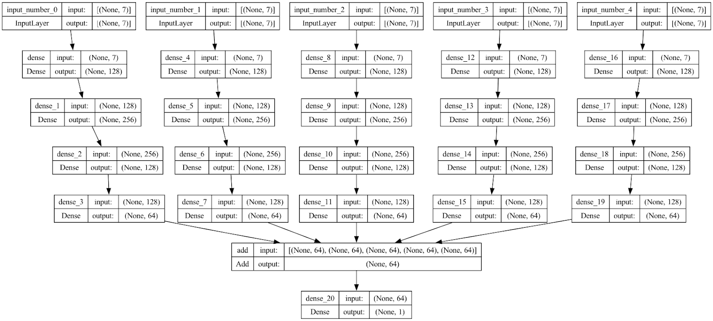
five atom problem

Slide 9
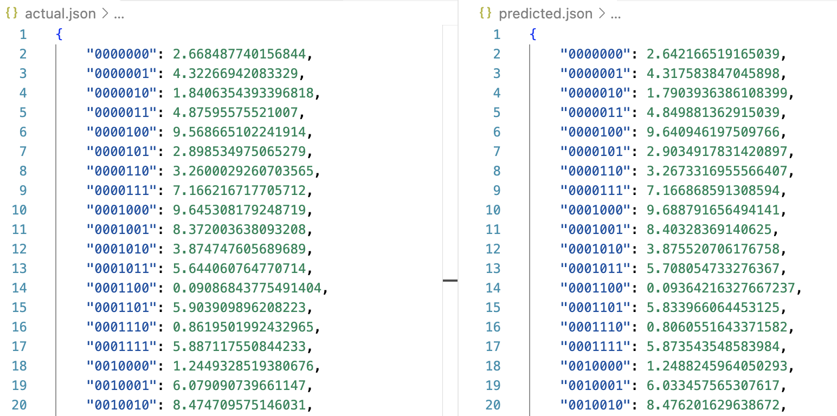
analysis
Run Index | Epochs | Total Samples | Test MSE
1 | 30 | 10⁶ | 2.237 x 10⁻¹¹
2 | 200 | 10⁵ | 9.936 x 10⁻¹¹
3 | 1.7 x 10³ | 10⁴ | 1.853 x 10⁻⁹
4 | 4 x 10³ | 5 x 10³ | 4.869 x 10⁻⁷
5 | 6 x 10³ | 3 x 10³ | 1.89 x 10⁻⁴
6 | 10 x 10³ | 10³ | 4.102

Slide 10
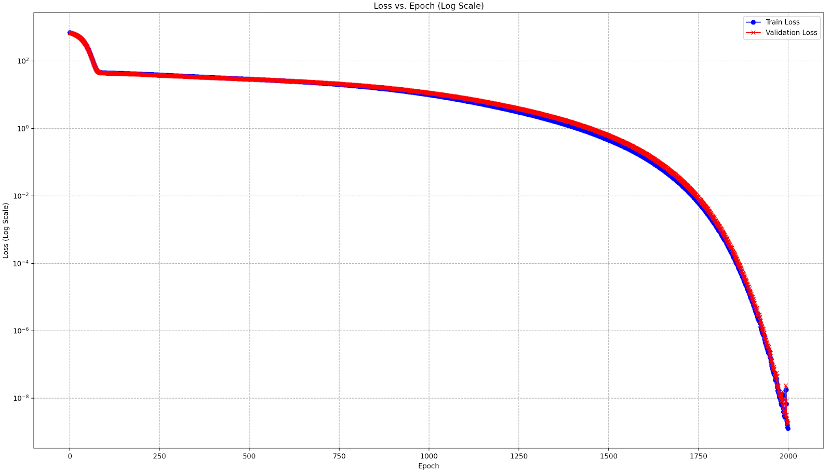
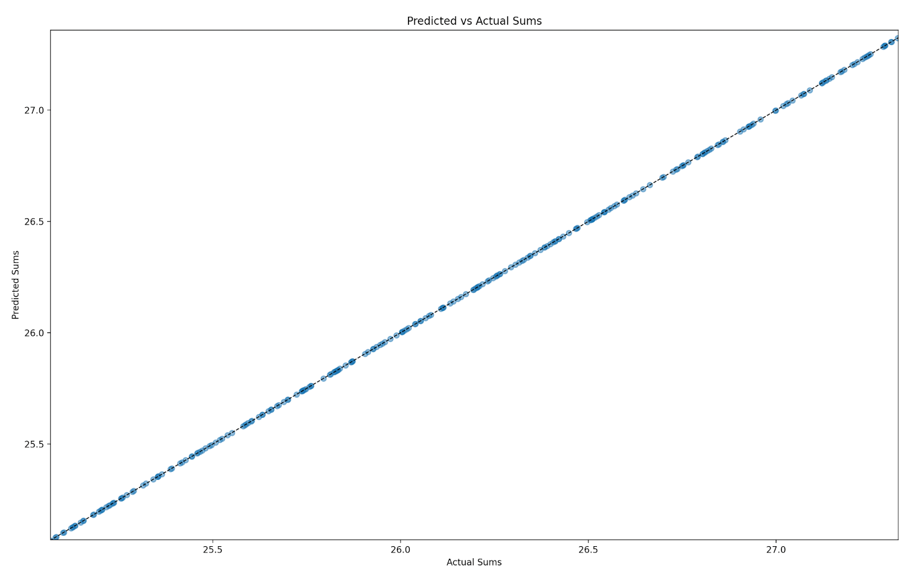
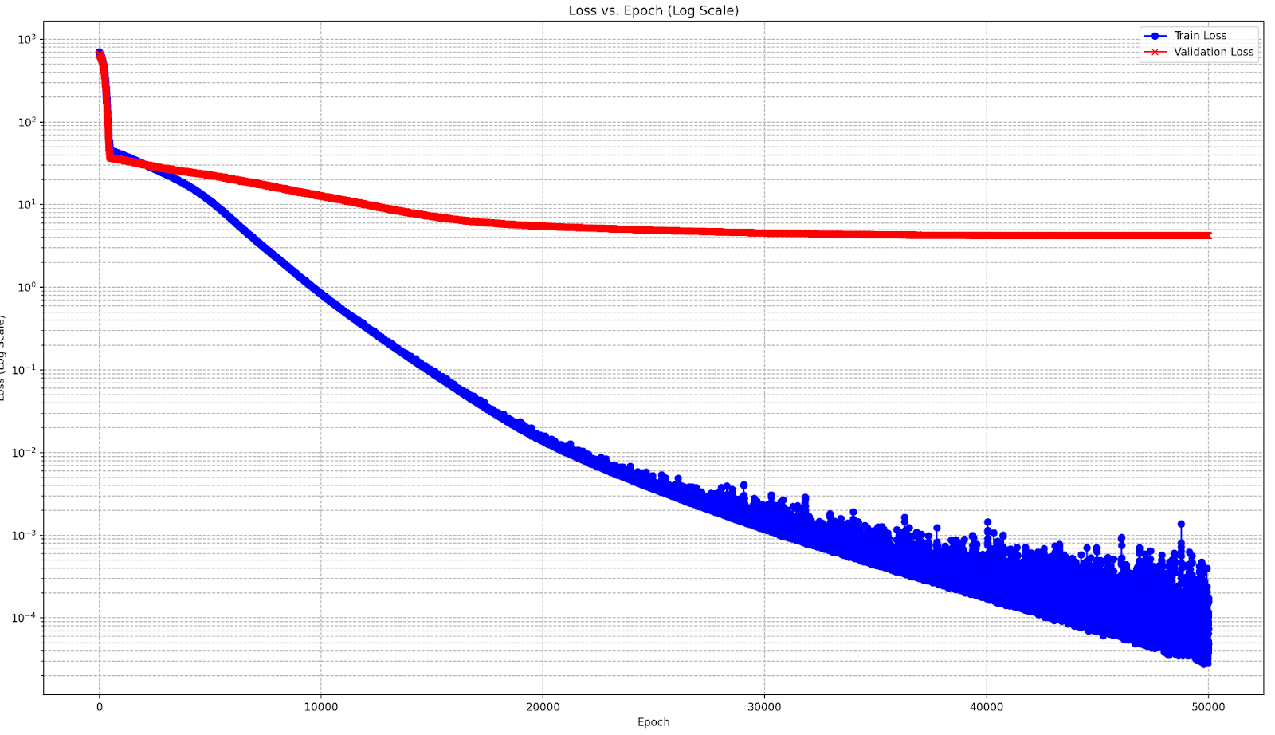
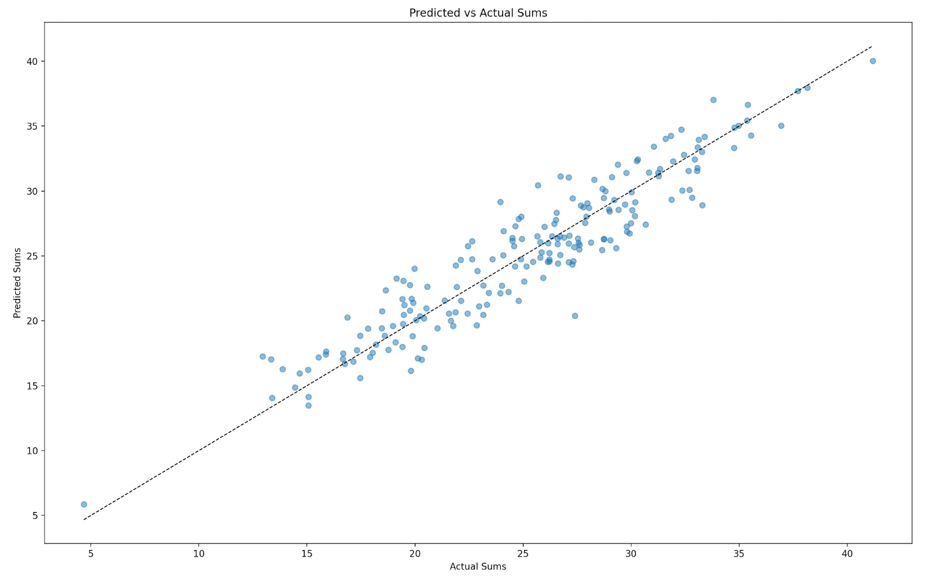
Epochs: 1.7 x 10³ | Total Samples: 10⁴ | Test MSE: 1.853 x 10⁻⁹
Epochs: 10 x 10³ | Total Samples: 10³ | Test MSE: 4.102

Slide 11
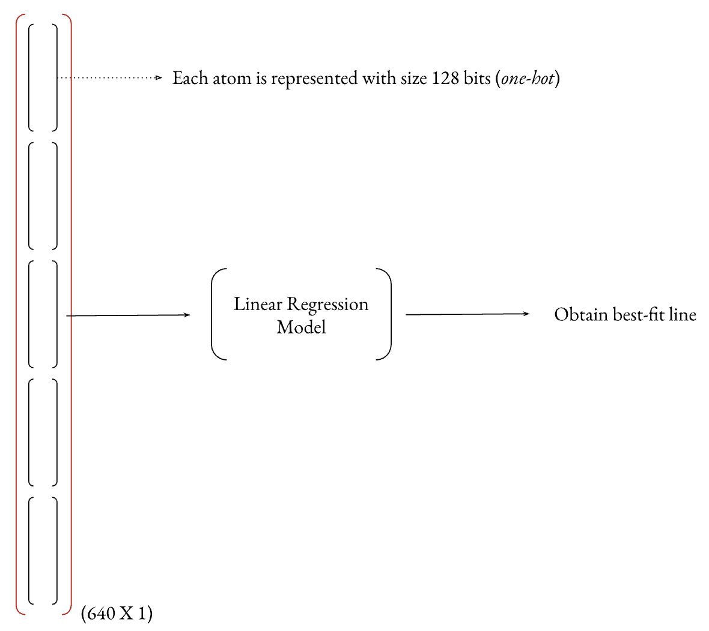
Linear regression
Models the relationship between two variables (input and output) by fitting a linear equation to observed data
y = mx + c (straight line)
7-bit representations are not useful with linear regression
Consider the 2-atom problem, where two atoms (each 7-bit) is represented using a long 14-bit sequence meaning that each bit is treated as an independent feature, but the mapping from the 7-bit sequence to its decimal representation is non-linear (exponential)
128-bit one hot encoding
[0 0 0 0 0 0 0 0 0 0 0 0 0 0 0 0 0 0 0 0 0 0 0 0 0 0 0 0 0 0 0 0 0 0 0 0 0 0 0 0 0 0 0 0 0 0 0 0 0 0 0 0 0 0 0 0 0 0 0 0 0 0 0 0 0 1 0 0 0 0 0 0 0 0 0 0 0 0 0 0 0 0 0 0 0 0 0 0 0 0 0 0 0 0 0 0 0 0 0 0 0 0 0 0 0 0 0 0 0 0 0 0 0 0 0 0 0 0 0 0 0 0 0 0 0 0 0 0]

Slide 12
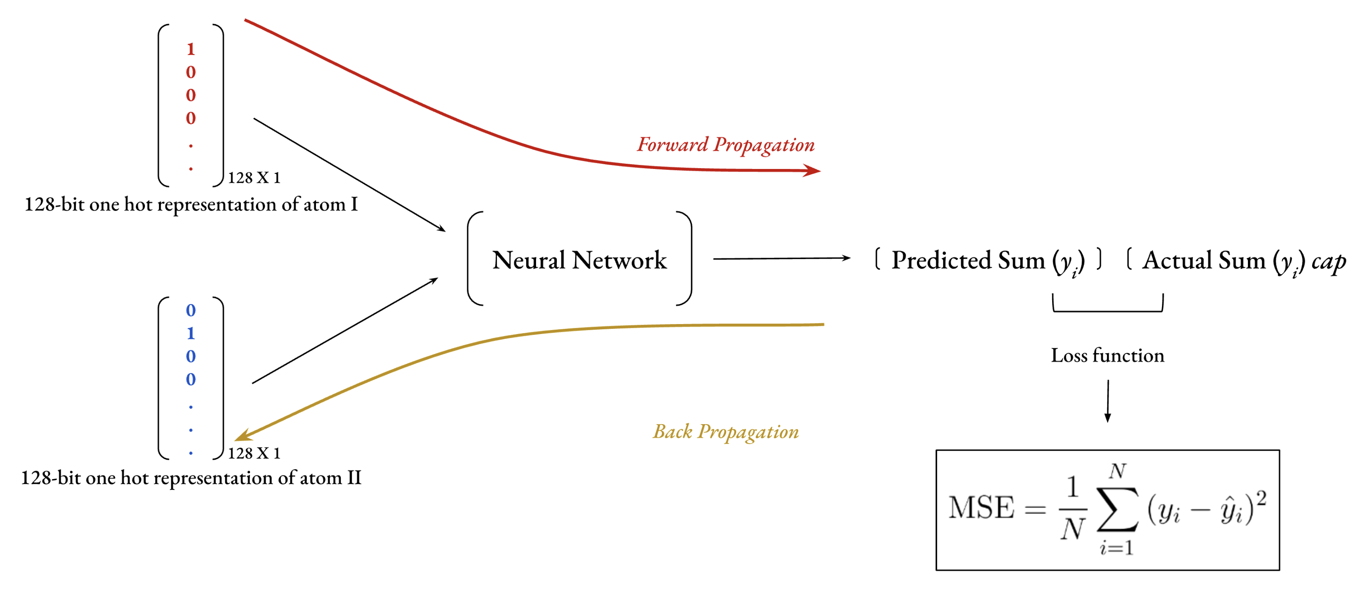
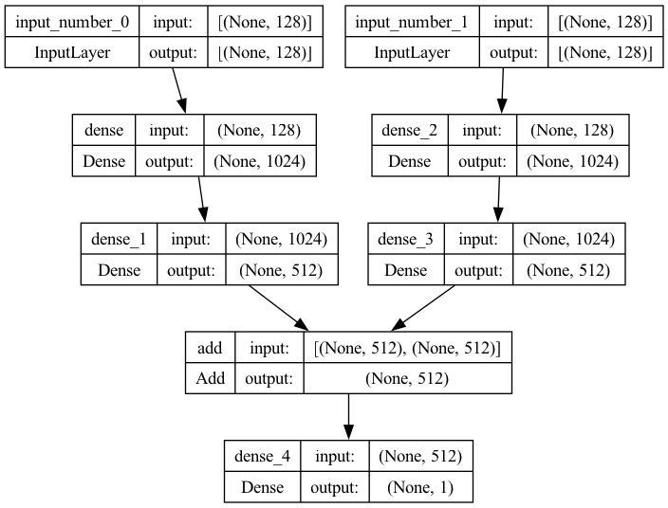
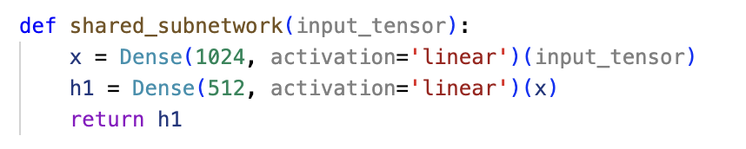
TWO-ATOM PROBLEM
[0 0 0 0 0 0 0 0 0 0 0 0 0 0 0 0 0 0 0 0 0 0 0 0 0 0 0 0 0 0 0 0 0 0 0 0 0 0 0 0 0 0 0 0 0 0 0 0 0 0 0 0 0 0 0 0 0 0 0 0 0 0 0 0 0 1 0 0 0 0 0 0 0 0 0 0 0 0 0 0 0 0 0 0 0 0 0 0 0 0 0 0 0 0 0 0 0 0 0 0 0 0 0 0 0 0 0 0 0 0 0 0 0 0 0 0 0 0 0 0 0 0 0 0 0 0 0 0]

Slide 13
“Is Linear Regression better than Deep Neural Networks?”
THANK YOU

